Slide 1
HySec-Flow: Privacy-Preserving Genomic Computing with SGX-based Big-Data Analytics Framework
Chathura Widanage, Weijie Liu, Jiayu Li, Hongbo Chen, XiaoFeng Wang, Haixu Tang, Judy Fox
Indiana University and University of Virginia

Slide 2
Privacy-Preserving Computing
Security and privacy issues have received increasing attention in big-data analytics performed on public or commercial clouds. personal genomic data contain identifiable information concerning human individuals.
Homomorphic encryption (HE) allows users to perform computation directly on encrypted data. HE introduces several magnitudes of computational overheads.
A promising alternative: New hardware supporting trusted execution environment (TEE), in which sensitive data are kept on secure storage and processed in an isolated environment, called the enclave.
We use Genomics applications (BWA) as an example and illustrate the idea that is general for any field with data data privacy components.

Slide 3
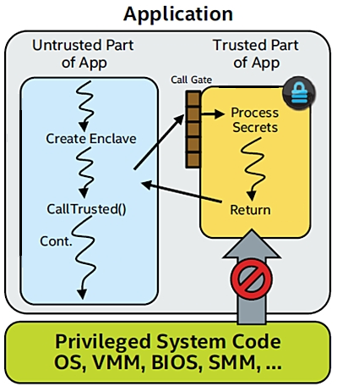
Intel® Software Guard Extensions (Intel® SGX)
Intel SGX is a set of x86 instruction extensions that offer hardware-based memory encryption and isolation for application code and data.
CPU instructions used by applications to protect critical secrets from unauthorized access:
Against software attacks originated at any privilege level
Against many hardware based attacks
Applications are modified split into trusted and untrusted parts

Slide 4
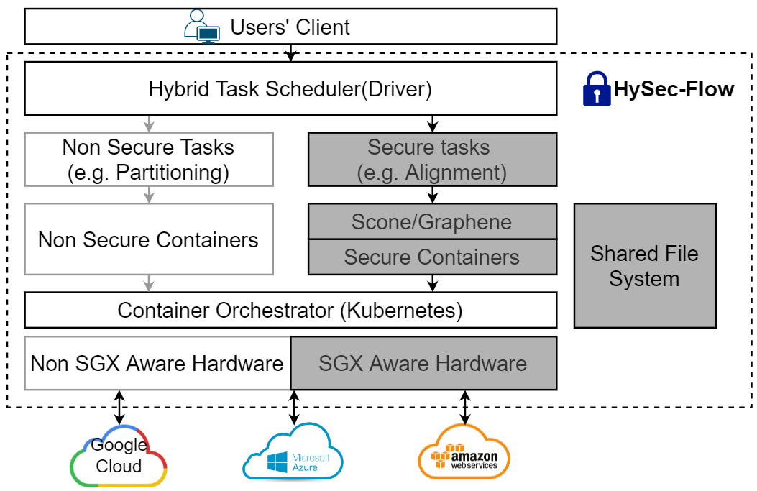
HySec-Flow Framework Overview

Slide 5
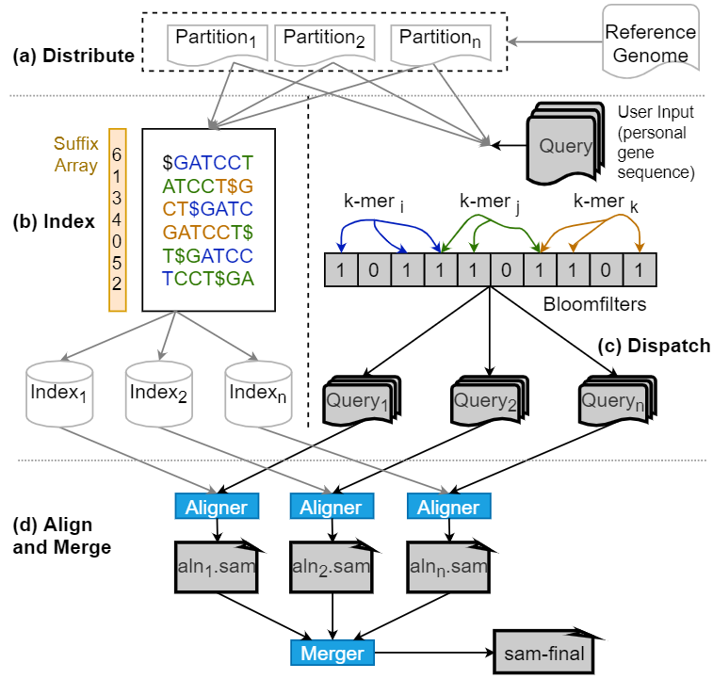
The conventional
(Untrusted) workflow
Distribute
the set of target sequences is partitioned into several subsets
Index
The partitions generated are indexed using a popular read alignment tool like BWA. This operation can be performed parallelly on each partition utilizing the available computing resources of the cluster.
Dispatch
The dispatch stage is performed to reduce the search space of an input DNA sequence within each partition. This can be performed by utilizing many application-dependent techniques.
Align & Merge
aligns the reads against the target sequence

Slide 6
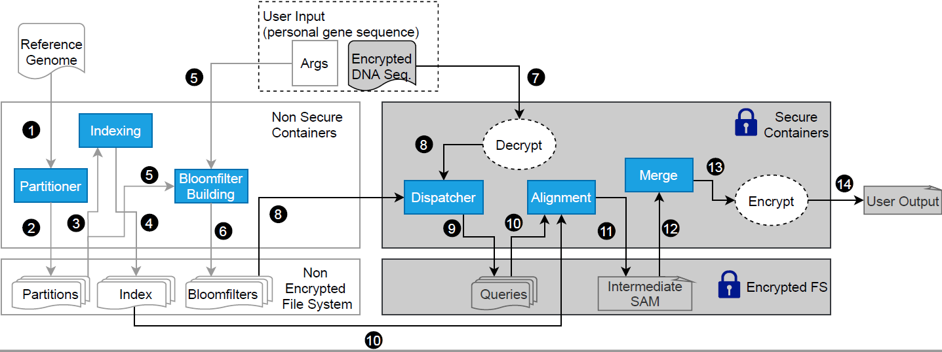
Workflow of Privacy-Preserving Computing Framework
Note such hybrid workflow is common across
all application with data privacy issues!

Slide 7
Partition, Indexing and Bloom Filter Building[1 - 6]
Split the reference genome sequence into multiple p number of partitions such that each partition can be individually indexed and searched on different nodes of the cluster.
The partitions generated are indexed using a popular read alignment tool like BWA. This operation can be performed parallelly on each partition utilizing the available computing resources of the cluster.
Compute a bloom filter for each partition by inserting sub-sequences of length 'b' of the reference genome partition with overlaps of length 'l'.
These tasks works only on non-sensitive data which are publicly available.
All the tasks are executed one time for the same reference genome, same p, b and l.

Slide 8
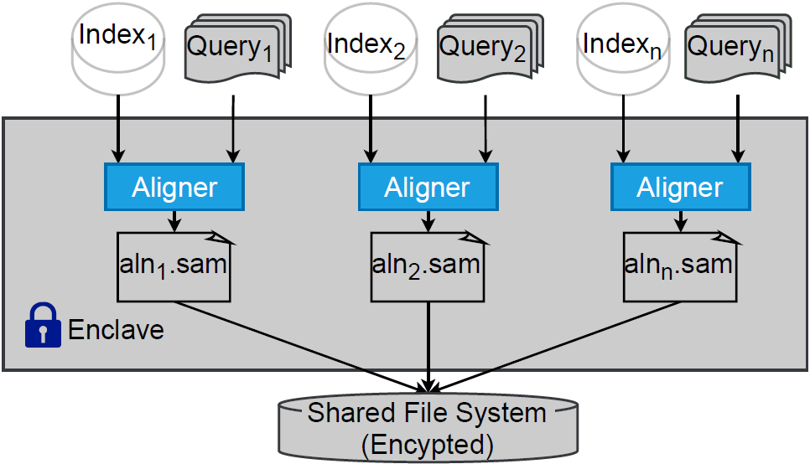
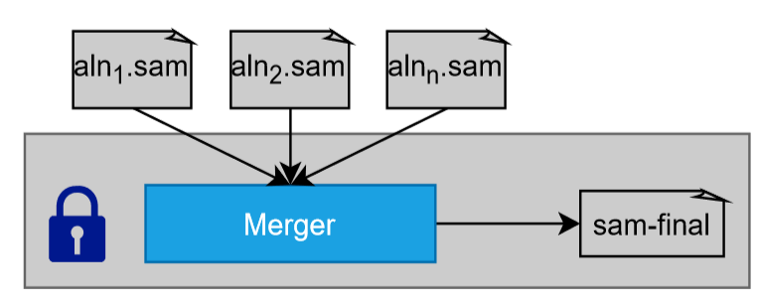
Alignment & Merge [10 - 14]
Alignment is performed using BWA for each partition.
This task has to run on Scone or Graphene to avoid complex code changes to support intel SGX.
This step could run sequentially on a single node or distribute over multiple nodes due to the pleasingly parallel nature of the task.
p outputs from the alignment tasks are merged within a secure environment to produce the final output expected by the user.
The output will be sealed using the user's shared key before dispatch it to the user.

Slide 9
Security
Analysis
SGX Enclave can protect the code/data integrity even when the executable is loaded into a library OS.
Disk I/O has been safeguarded by Scone/Graphene’s protected filesystem, which utilizes AES-GCM to encrypt user data and immediate data during the computation.
Under our threat model, the only security risk is key delivery, which is protected by the secure channels we built after trust establishment. Therefore, file tampering attacks can be defeated
Side channels have been considered to be a threat to trusted execution environments, including SGX.

Slide 10
Security Design
Protected File System
We use SCONE/Graphene-SGX’s protected file system to guarantee the all outputs are encrypted.
Attestation and Secret Provisioning
Our attestation and key provisioning mechanism can provide and manage keys for I/O encryption.
More specifically, we devise an attestation plane, including
An attestation management service,
A local attestation service on each computing node,
A modified Graphene container with attestation interfaces.
Notes:
The attestation management service (AMS) can establish the trust channel and distribute user/client’s key to each computing node.
The local attestation service (LAS) will communicate with the AMS and transfer the key to the modified Graphene container.
The modified Graphene will verify the integrity of the running program and accept the key for later I/O encryption.
All the communication messages between AMS, LAS, and the modified Graphene container will be encrypted.

Slide 11
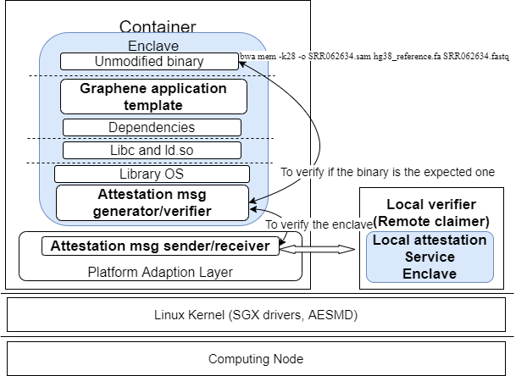
Security/Graphene
Attestation Interfaces
In Graphene’s LibOS:
Attestation msg generator
Attestation msg verifier
In Graphene’s PAL:
Attestation msg sender
Attestation msg receiver
Notes:
In the modified Graphene-SGX, we plan to add 1) an attestation message verifier in Graphene’s library OS, to verify if the running program (code and data) is the expected one; 2) an attestation message sender/receiver at Graphene’s PAL (Platform Adaption Layer), to communicate with the LAS (Local Attestation Server).

Slide 12
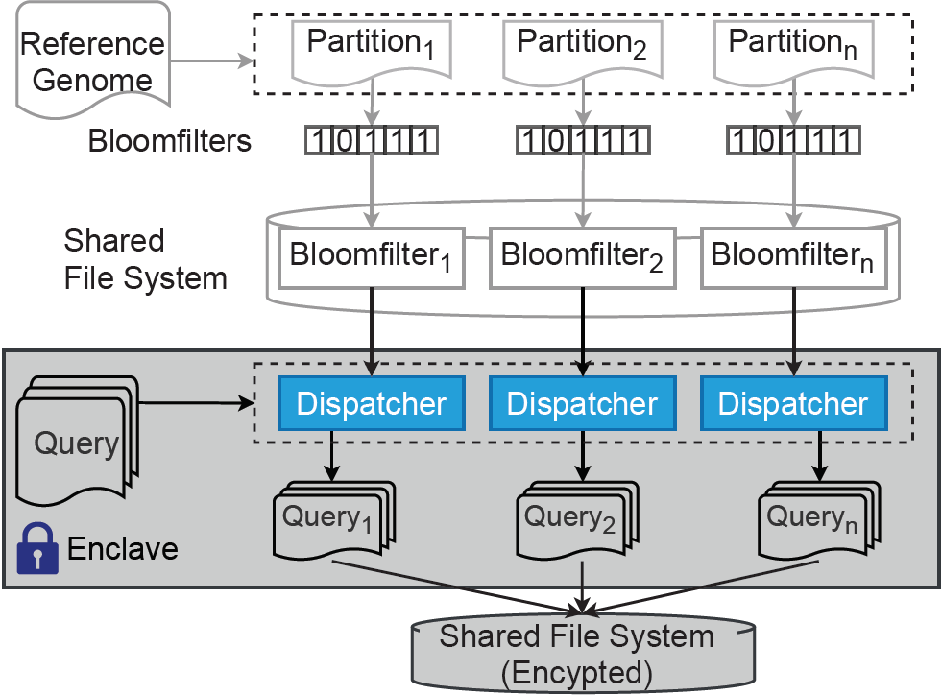
Dispatch [ 7 - 9]
Dispatch is the process of partitioning the user’s query(DNA sequence) into p partitions.
The dispatch step can be parallelly run for each reference genome partition.
Dispatch works on sensitive data and needs to run inside intel SGX.
Query_{n} contains subsequences that would possible present in Partition_{n}
Outputs are written into a shared file system in an encrypted format.

Slide 13
SGX overhead
Overhead from enclave initialization
We measure the enclave initialization time by varying the HeapMaxSize (16M, 64M, 256M, 1024M, 4096M).
Enclave initialization time is about 0.04 seconds per MB of the configured maximum heap size.
Overhead from OCall/ECall
The overhead of OCall and Ecall are 5.27 and 4.65 seconds per million calls respectively. As a comparison, making the same calls within the untrusted environment only costs 1.3 ms per million calls.
Overhead from EPC page swapping
An enclave can only utilize what a Processor Reserved Memory (PRM) can provide at the current stage, which is 128MB. In actual use,the usable memory size for an SGX application is only around 90MB.
When a larger data set may not fit into this space, an EPC page swap occurs.

Slide 14
Experimental Results

Slide 15
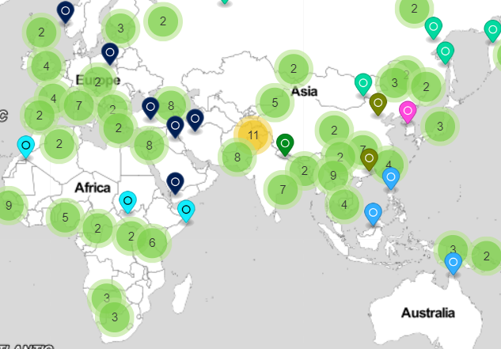
1000 Genomes Project
The 1000 Genomes Project (1000 Genomes | A Deep Catalog of Human Genetic Variation (internationalgenome.org)) is an international research effort to establish largest public catalogue of human variation and genotype data.
The 1000 Genomes Project created a catalogue of common human genetic variation, using openly consented samples from people who declared themselves to be healthy. The reference data resources generated by the project remain heavily used by the biomedical science community.

Slide 16
Experimental setup & data set
Our experiments are conducted on a 10-nodes SGX-enabled cluster, with each node has an Intel(R) Xeon(R) CPU E3-1280 v5 @ 3.70GHz CPU and 64G RAM. The SGX enclaves are initialized with 8GB heap space with both Scone and Graphene.
Data Set | Source | # Reads | bp/read
SRR062634.filt.fastq | 1000 Genomes | 309K | 100
SRR062634_1 | 1000 Genomes | 24M | 100
SRR062634_2 | 1000 Genomes | 24M | 100

Slide 17
Intel’s new hardware and large Enclave

Slide 18
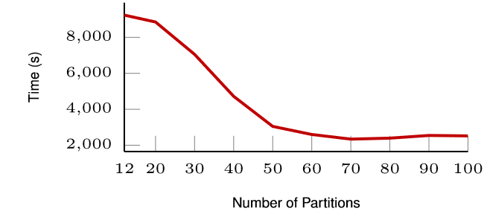
Optimal partitions for splitting the reference genome
The runtime is measured by sequentially run the alignment for dispatched reads on one single node using SGX via Scone. When the number of partitions is greater than 60, it got flattened.
Human reference genome data is about 3.2 GB, this translates to the reference partition size around or smaller than 50 MB. With the usable memory space around 90 MB for SGX, this optimal configuration suggests that the entire indexing table can fit into the SGX EPC to minimize the unnecessary EPC swapping, thus improving the overall performance.

Slide 19
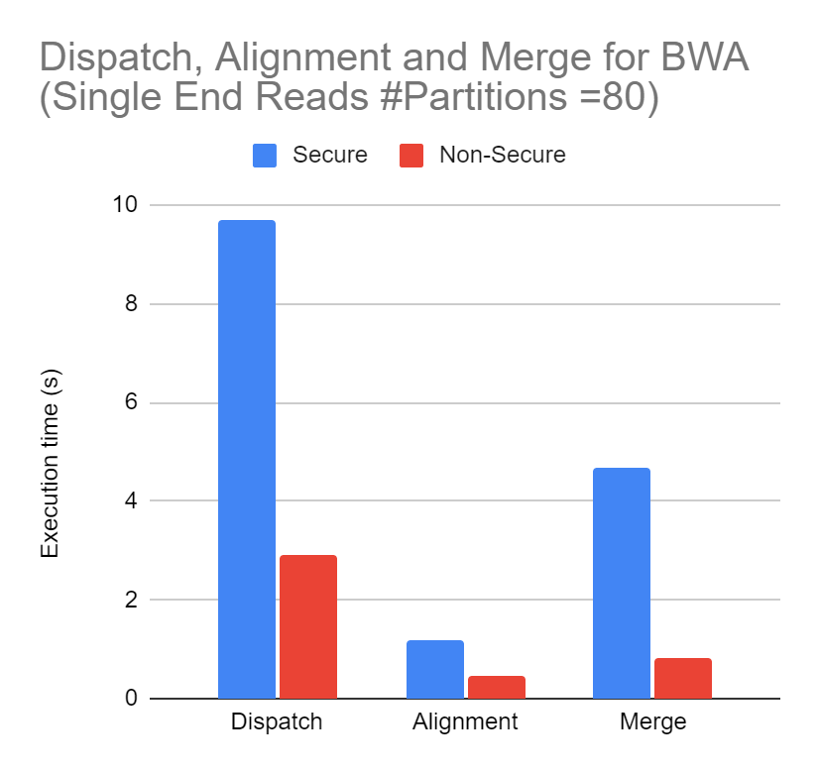
Secure vs. Non-Secure
In the best case, we can run the single end alignment pipeline securely in 15.53 seconds (9.68s in parallel dispatching, 1.18s in parallel alignment over 80 nodes and 4.66s in merging) by partitioning the problem into 80 subtasks.
Even in the worst case that has only one SGX enabled node, we can expect to complete the alignment in 792.46 seconds running sequentially.

Slide 20
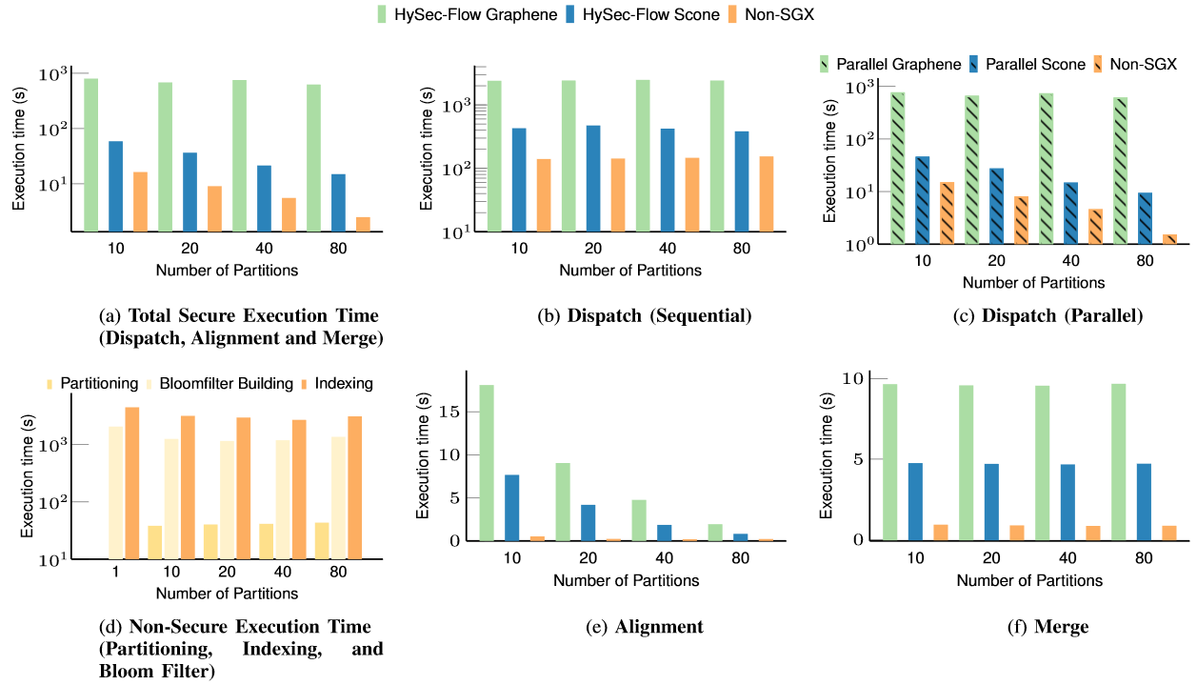
Comparison of the HySec-Flow execution time of Scone & Graphene

Slide 21
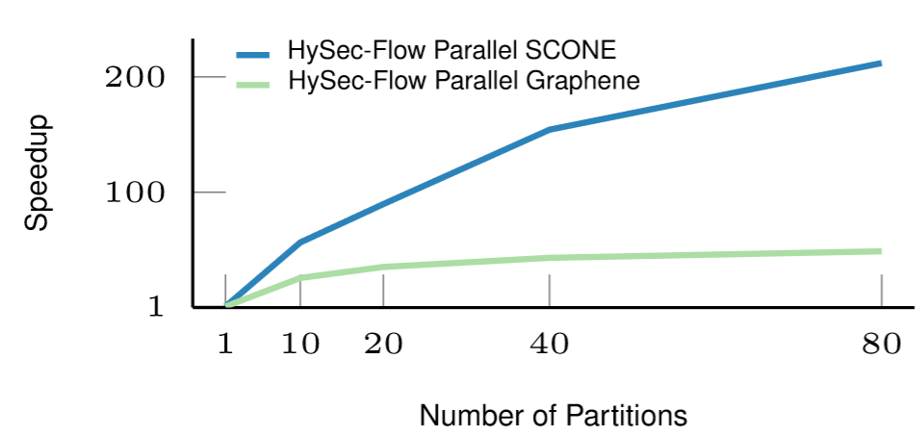
Speedup of HySec-Flow over Scone and Graphene
The best-case of HySec-Flow execution time (15.52 seconds) is 6x and 212x speedup compared to non-SGX execution (91 s) and Scone execution (3291 s) respectively.

Slide 22
HySec-Flow Conclusions
An architecture for an end-to-end workflow of privacy-preserving genomic data analytics using Intel's SGX technology.
Speedup of up to 212x (for 80 partitions) compared to the naive approach directly executing BWA within the Scone framework.
The speedup is mainly achieved from the process level parallelism as well as significantly reduced search space by the bloom filter based dispatch step.
HySec-Flow can be easily adapted to a category of many genomics applications where the algorithms are pleasantly data-parallel, e.g., for genome variation calling, for gene expression analysis using RNA-seq data , and peptide identification in clinical proteomics.

Slide 23
Future HySec-Flow Work
HySec-Flow can be extended to handle multiple search tasks from different users by adding a new 'driver' component to securely accept jobs from users and assign containers on demand from a heterogeneous pool of containers.
Further integrate into Harp and HPC libraries; note workflows and HPC kernel libraries address different computing challenges and can naturally be linked
Intel has major SGX improvements in latest “Ice Lake and “Sapphire Rapids” chips with much larger enclaves
Integrate Harp and HySec-Flow into Intel OneAPI framework
Other hybrid workflows (secure / non-secure) other than genome sequencing can be ported into the framework and scale to highest performance using a programmable API.
HySec-Flow can be extended to implement privacy-preserving algorithms for other data-intensive computing tasks in epidemiology, genome variation calling and gene expression analyses

Slide 24
Conclusions &
Future Work

Slide 25


Acknowledgement
This work is partially supported by NSF grant No.1838083 on BIGDATA: IA: Enabling Large-Scale, Privacy-Preserving Genomic Computing with a Hardware-Assisted Secure Big-Data Analytics Framework, NSF grant CCF-1918626 Expeditions: Collaborative Research: Global Pervasive Computational Epidemiology, NSF grant No. 1835631 CINES: A Scalable Cyberinfrastructure for Sustained Innovation in Network Engineering and Science, and NIH R01HG010798: Secure and Privacy-preserving Genome-wide and Phenome-wide Association Studies via Intel Software Guard Extensions (SGX). We appreciate technical support from Intel Inc. and would like to thank Robert Henderson and the system team for their assistance with our experiments on the SGX cluster.

